Slide 1
Week 7 Classes: A Deeper Look
CS 331
An introduction to C++ and Object-Oriented Programming
MD Romael Haque

Slide 2
Constructors
A constructor is a member function that is automatically called when a class object is created.
Most often programmers use a constructor to initialize an object’s member variables. However, it can do anything a normal function can do.
A constructor looks like a regular function except that its name must be the same as the name of the class it is a part of. This is how the compiler knows that a particular member function is a constructor.

Slide 3
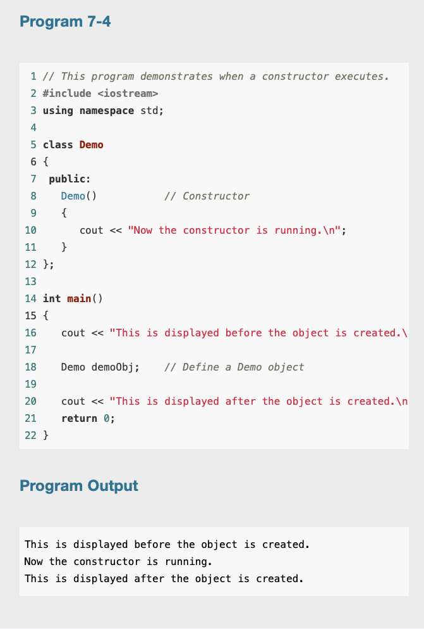
Constructors

Slide 4

Constructors
In the example, we defined the constructor as an inline function inside the class declaration.
However, like any other class member function, we could have just put its prototype in the class declaration and then defined it outside the class.
In that case, we would need to add the name of the class the function belongs to and the scope resolution operator in front of the function name.
But the name of the constructor function is the same as the class name, so the name would appear twice.

Slide 5
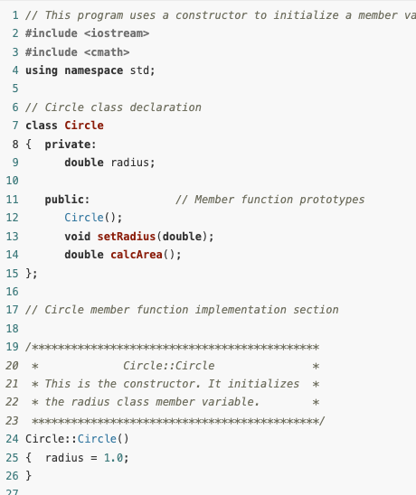
Example
A constructor that initializes an object’s member data.
The constructor is defined outside of the class.

Slide 6
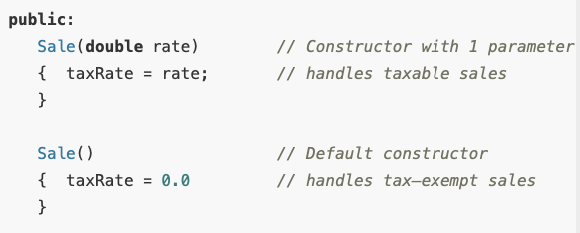
Overloading Constructors
Class member functions may be overloaded, including the constructor. One constructor might take an int argument, for example, while another constructor takes a double. There could even be a third constructor taking two integers. As long as each constructor has a different list of parameters, creating a unique signature, the compiler can tell them apart.

Slide 7
Default Constructors
A default constructor is a type of constructor in c++ that is automatically provided by the compiler if no constructors are explicitly defined in a class.
Its main purpose is to initialize objects without requiring any arguments.
In C++, the default constructor initializes all member variables to default values (e.g., 0 for numeric types, false for booleans, etc.).

Slide 8
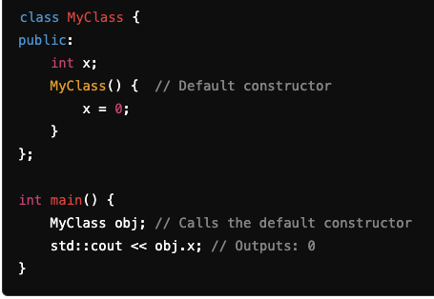
Default Constructors
Characteristics of a Default Constructor:
No Parameters: It does not take any arguments.
Automatic Creation: If no other constructors (parameterized or otherwise) are defined, the compiler creates a default constructor.
Implicit and Explicit Declaration: You can define a default constructor explicitly, but if none is provided, the compiler will implicitly create one.

Slide 9
Default Constructors
Any time you design a class that will have constructors, it is considered good programming practice to include a default constructor.
If you do not have one, and the program tries to create an object without passing any arguments, it will not compile.
This is because there must be a constructor to create an object.
In order to create an object that passes no arguments, there must be a constructor that expects no arguments a default constructor.
If the programmer doesn’t write any constructors for a class, the compiler automatically creates a default constructor for it.
However, when the programmer writes one or more constructors, even ones that all have parameters, the compiler does not create a default constructor. So it is the responsibility of the programmer to do this.

Slide 10
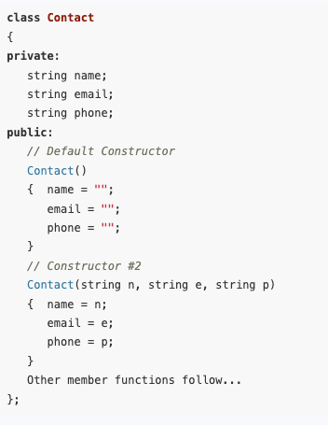
Constructor Delegation
Often, a class will have multiple constructors that perform a similar set of steps, or some of the same steps. For example, look at the following Contact class:
In this class, both constructors perform a similar operation. They assign values to the name, email, and phone member variables.
The default constructor assigns empty strings to the members, and the constructor with parameters assigns specified values to them.

Slide 11
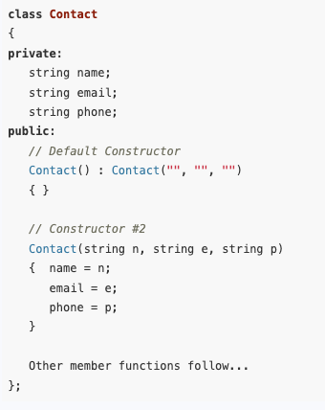
Constructor Delegation
In C++ 11, it is possible for one constructor to call another constructor in the same class. This is known as constructor delegation.
In this version of the class, the default constructor calls constructor #2. Notice that a colon appears at the end of the default constructor's header, followed by a call to constructor #2 with three empty strings listed inside the parentheses.
Any time the Contact class default constructor is called, it calls constructor #2, passing the empty strings as arguments.
As a result, the empty strings are assigned to the object's name, email, and phone member variables.

Slide 12
Destructors
A destructor is a member function that is automatically called when an object is destroyed.
Destructors are public member functions with the same name as the class, preceded by a tilde character (~).
For example, the destructor for the Rectangle class would be named ~Rectangle.
Destructors are used to perform shutdown procedures when an object ceases to exist.

Slide 13
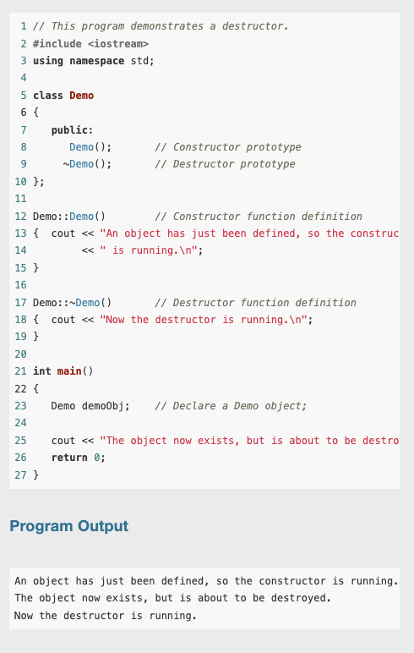
Example
In addition to the fact that destructors are automatically called when an object is destroyed, the following points should be mentioned:
Like constructors, destructors have no return type.
Destructors cannot accept arguments, so they never have a parameter list.
Because destructors cannot accept arguments, there can only be one destructor.

Slide 14
Private Member Functions
Until now all of the class member functions you have seen have been public functions.
This means they can be called by code in programs outside the class. Often, however, a class needs functions for internal processing that should not be called by code outside the class.
These functions should be made private.
Private member functions may only be called from a function that is a member of the same class.

Slide 15
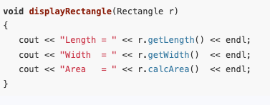

Passing Objects to Functions
Class objects may be passed as arguments to functions.
For example, the following function has a parameter that receives a Rectangle object.
The following lines of code create a Rectangle object with length 15 and width 10, and then pass it to the displayRectangle function.

Slide 16
Passing Objects to Functions
As with regular variables, objects can be passed to functions by value or by reference.
In the Rectangle example, box is passed to the displayRectangle function by value.
This means that displayRectangle receives a copy of box. If displayRectangle called any Rectangle class mutator functions, they would only change the copy of box, not the original.
If a function needs to store or change data in an object’s member variables, the object must be passed to it by reference.

Slide 17
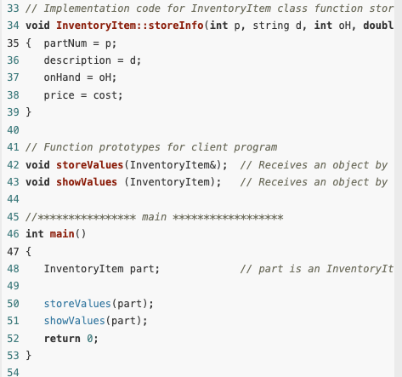
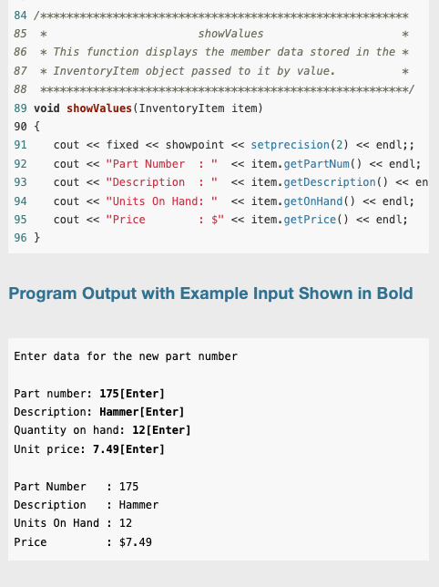
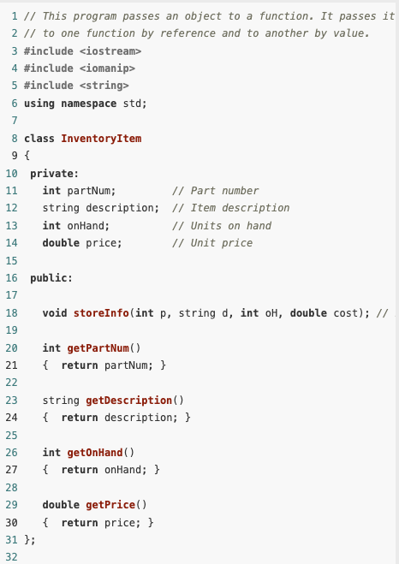
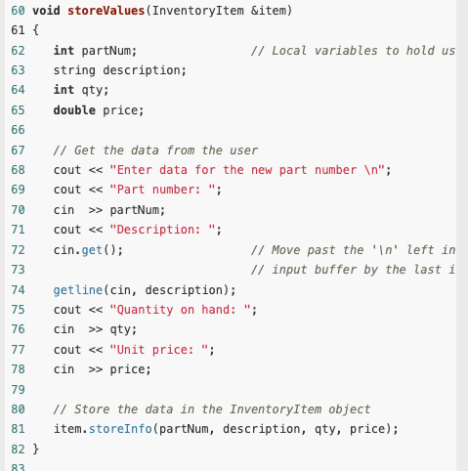
Example

Slide 18
Constant Reference Parameters
Passing an object by value requires making a copy of all of the object’s members.
This can slow down a program’s execution time, particularly if it has many members.
Passing an object by reference is faster because no copy has to be made since the function has access to the original object.
For this reason it is generally preferable to pass objects by reference.

Slide 19
Constant Reference Parameters
Passing an object by reference does have a disadvantage, however.
Because the function has access to the original object, it can call its mutator functions and alter its member data.
This is why we normally do not pass variables by reference when we want to safeguard their contents.
But, there is a solution. To protect an object when it is passed as an argument, without having to make a copy, it can be passed as a constant reference.

Slide 20

Constant Reference Parameters
To declare a parameter to be a constant reference parameter, we must put the key word const in the parameter list of both the function prototype and function header.
Now the showValues function can only call InventoryItem functions that also have the key word const listed in their function prototype and header, like this: double getPrice() const
If showValues tried to call any other InventoryItem functions, a compiler error would occur.
Notice that when showValues is modified to have a constant reference parameter, only the function prototypes and headers are changed to include the word const. The body of the showValues function and the call to showValues do not change.

Slide 21
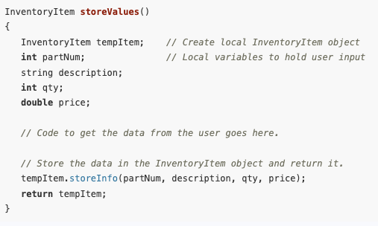
Returning an Object from a Function
Just as functions can be written to return an int, double, or other data type, they can also be designed to return an object.
Here is an example of how the InventoryItem object used in previous program could be created in the storeValues function and then returned to the calling function. Notice that this new version of storeValues does not accept any arguments, and its return type is now InventoryItem rather than void.
The main function could then create part as shown here, initializing it with the InventoryItem object returned by the storeValues function.
InventoryItem part = storeValues();

Slide 22
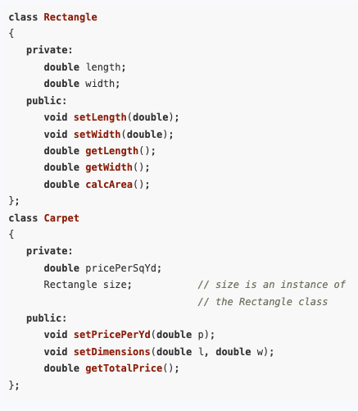
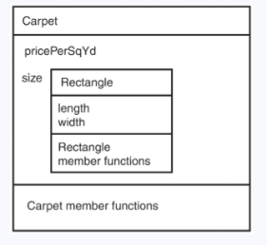
Object Composition
It is possible for a class to have a member variable that is an instance of another class.
Sometimes it’s helpful to nest an object of one class inside another class.
Notice that the Carpet class has a member variable named size, which is an instance of the Rectangle class. The Carpet class can use this object to store the room dimensions and to compute the area for a carpet purchase.

Slide 23
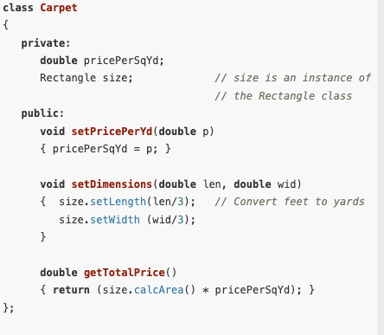
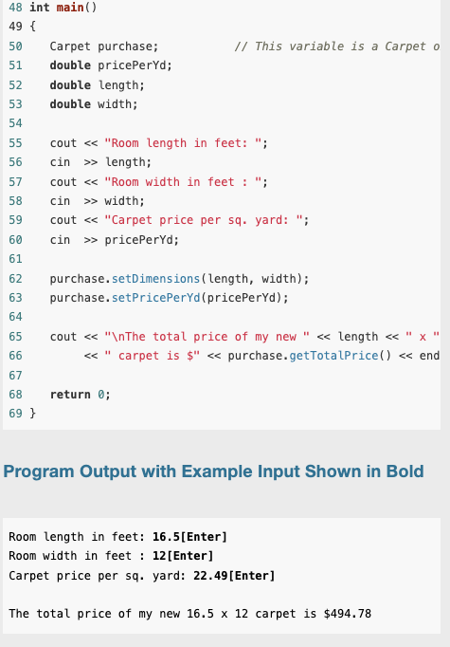
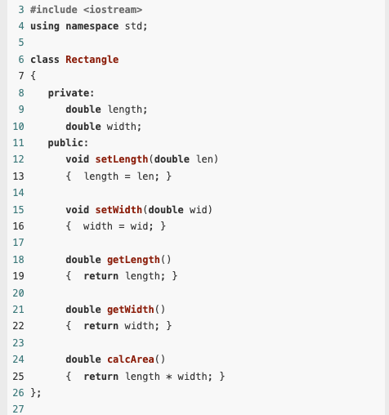
Example
Notice that the client program, which defines purchase, a Carpet object, only uses it to call Carpet class functions, not Rectangle class functions. It does not even know that the Carpet class has a Rectangle object inside it. Also, follow how Carpet class functions call Rectangle functions.
Just as the user program calls Carpet functions through the name of its Carpet object, the Carpet class functions must call Rectangle functions through the name of its Rectangle object. size.calcArea()

Slide 24
Separating Class Specification, Implementation, and Client Code
Usually class declarations are stored in their own header files and member function definitions are stored in their own .cpp files.
In the programs we’ve looked at so far, the class declaration, the member function definitions, and the application program that uses the class are all stored in one file.
A more conventional way of designing C++ programs is to store these in three separate files.

Slide 25
Separating Class Specification, Implementation, and Client Code
Typically, program components are stored in the following fashion:
lass declarations are stored in their own header files. A header file that contains a class declaration is called a class specification file. The name of the class specification file is usually the same as the name of the class, with a .h extension. For example, the Rectangle class would be declared in the file Rectangle.h.
Any program that uses the class should #include this header file.
The member function definitions for a class are stored in a separate .cpp file, which is called the class implementation file. The file usually has the same name as the class, with the .cpp extension. For example the Rectangle class member functions would be defined in the file Rectangle.cpp.
The class .cpp file should be compiled and linked with the application program that uses the class. This program, also known as the client program, or client code, is the one that includes the main function. This process can be automated with a project or make utility. Integrated development environments such as Visual Studio also provide the means to create multi-file projects.

Slide 26
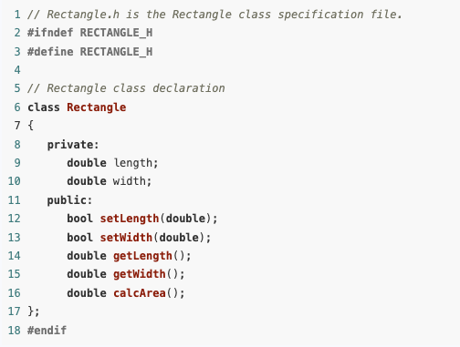
Example
This is the specification file for the Rectangle class. It contains only the declaration of the Rectangle class. It does not contain any member function definitions.
When we write other programs that use the Rectangle class, we can have an #include directive that includes this file.
That way, we won’t have to write the class declaration in every program that uses the Rectangle class.
This file also introduces two new preprocessor directives: #ifndef and #endif.
The #ifndef directive that appears in line 2 is called an include guard. It prevents the header file from accidentally being included more than once.
When your main program file has an #include directive for a header file, there is always the possibility that the header file will have an #include directive for a second header file.
If your main program file also has an #include directive for the second header file, the preprocessor will include the second header file twice.
Unless an include guard has been written into the second header file, an error will occur because the compiler will process the declarations in the second header file twice.
First, the Rectangle class declaration would be stored in the following Rectangle.h file.

Slide 27
Separating Class Specification, Implementation, and Client Code
The word ifndef stands for “if not defined.” It is used to determine whether or not a specific constant has already been defined with another #define directive.
When the Rectangle.h file is being compiled, the #ifndef directive checks for the existence of a constant named RECTANGLE_H.
If this constant has not been defined yet, it is immediately defined in line 3, and the rest of the file is included.
However, if the constant has already been defined, it means that this file has already been included.
In that case, it is not included a second time. Instead, everything between the #ifndef and #endif directives is skipped.
Note that the constant used in the #infdef and #define directives should be written in all capital letters and is customarily named FILENAME_H, where FILENAME is the name of the header file.

Slide 28
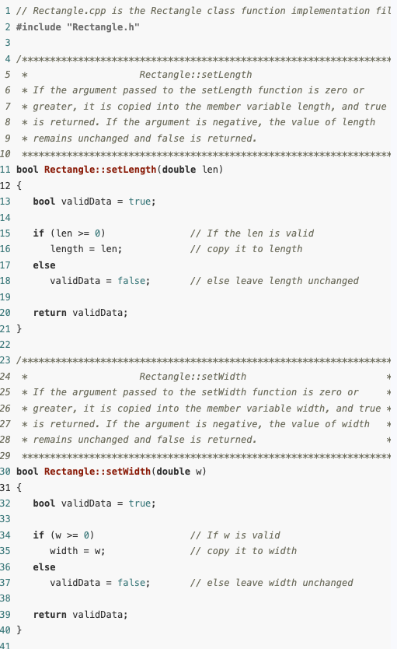
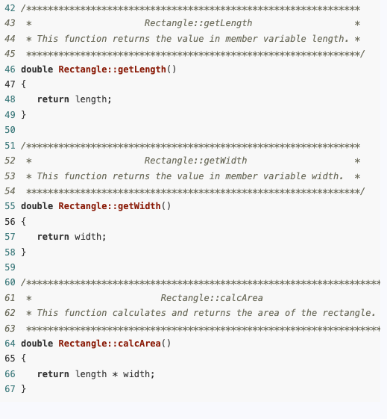
Separating Class Specification, Implementation, and Client Code
Next we need an implementation file that contains the class member function definitions.
The implementation file for the Rectangle class is Rectangle.cpp.

Slide 29
Separating Class Specification, Implementation, and Client Code
#include "Rectangle.h"
This directive includes the Rectangle.h file, which contains the Rectangle class declaration.
Notice that the name of the header file is enclosed in double-quote characters (" ") instead of angled brackets (< >).
When you include a C++ system header file, such as iostream, you enclose the name of the file in angled brackets. This indicates that the file is located in the compiler’s include file directory.

Slide 30
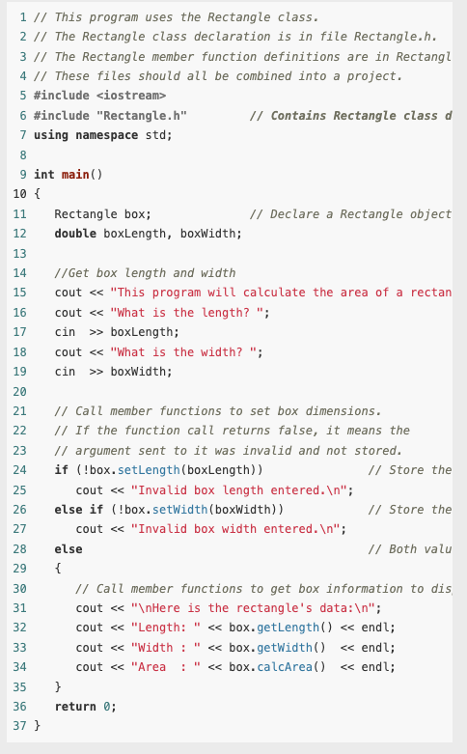
Finally
Now that we have created the three files for this program, the following steps must be taken to create an executable program.
First, the implementation file, Rectangle.cpp, should be compiled to create an object file. This file would typically be named Rectangle.obj.
Next, the main program file, located in file pr7–12.cpp, must be compiled to create an object file. This file would typically be named pr7–12.obj.
Finally, the object files pr7–12.obj and Rectangle.obj are linked together to create an executable file, which would be named something like pr7–12.exe.

Slide 31
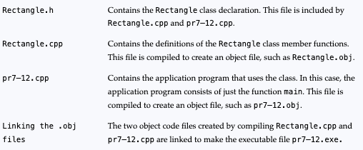
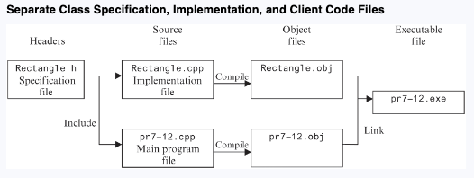
Summary

Slide 32
Advantages of Using Multiple Files
Encapsulation and Abstraction: Separating a class's implementation from its specification allows the client program to focus only on what the class does, not how it does it. This promotes abstraction, where programmers need to know only the class’s interface, not the internal implementation details.
Reusability and Modularity: Many different programs can use the same class without needing to include the class's full implementation. Instead, they can reference the class's specification and compiled object files, making code modular and reusable.
Ease of Maintenance: When a class's member functions need to be modified, only the implementation file needs to be changed and recompiled. Programs using the class don't need to be recompiled, only linked with the new object file, simplifying updates and maintenance.

Slide 33



Pointers to Class Objects
Declaring a pointer to a class is the same as declaring any other pointer type. For example, if Rectangle is defined as
You can declare a pointer to Rectangle and create a Rectangle object by writing
and you can assign the address of rect to pRect as follows:

Slide 34
Pointers to Class Objects
Now suppose that you want to access the members of the Rectangle object through the pointer pRect. Because *pRect is just another way of accessing rect, you might think that the expression *pRect.width will access rect.width, but this is not so.
The reason is that the dot selector has higher priority than the * operator, so *pRect.width is equivalent to *(pRrect.width). This last expression is a type error. To get it right, you must use parentheses to force the indirection operator * to be applied first, as shown here: (*pRect).width

Slide 35

Pointers to Class Objects
The following statements will correctly set the dimensions of the rectangle to 10 and 20.
The combined use of parentheses, the indirection operator, and the dot selector to access members of class objects via pointers can result in expressions that are hard to read.

Slide 36

Pointers to Class Objects
To solve this problem, C++ provides the structure pointer operator −> to use when you want to access a member of a class object through a pointer.
It consists of a hyphen – and a greater-than symbol > written next to each other to look like an arrow.
Using this operator, you can set the dimensions of the rectangle with these statements:

Slide 37

Pointers to Class Objects
Member functions of class objects can be called through a pointer.
In particular, if ptr is a pointer to an object that has a member function fun(), then the function can be called with either one of these two (equivalent) expressions:

Slide 38
The this Pointer and Constant Member Functions
By default, the compiler provides each member function of a class with an implicit parameter that points to the object through which the member function is called.
The implicit parameter is called this.
A constant member function is one that does not modify the object through which it is called.

Slide 39
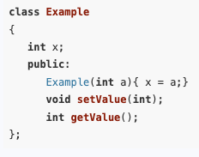

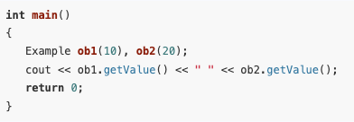
The this Pointer
We know that the different objects of a class type are called instances of that class and that each instance of a class has its own copy of the data members listed in the
These data members, called instance members because they belong to instances of the class, can have different values in different objects.
Thus, in the example, the instance member x in the ob1 object has a value of 10 while x in ob2 has a value of 20.
The getValue function has been invoked in a program and will print out 10 and 20

Slide 40

The this Pointer
Let’s take a look at this member function again:
This function is supposed to return the x member of some object of the Example class, but how does it know which object to use?
What happens is that by default, the compiler provides each member function of every class with an implicit parameter that is a pointer to an object of the class.
Thus, for example, the getValue function is equipped with a single parameter of type pointer to Example.

Slide 41

The this Pointer
Let’s take a look at this member function :
although written by the programmer to take a single parameter of type int, in reality has two parameters: an pointer to an object of the class Example, and the parameter specified by the programmer - int a
In all cases, the actual parameter for the implicit object parameter is the address of the object through which the member function is being called. Thus, in the call ob1.getValue() the implicit parameter passed to getValue is the address of ob1 (&ob1),
whereas in the call ob2.setValue(78) the implicit parameter passed to setValue is &ob2.

Slide 42
The this Pointer
The implicit pointer passed by the compiler to a member function can be accessed by code inside that function by using the reserved keyword this.
So for example, a member function of the Example class could access the object through which it is called by using the expression *this
Let’s look at an example:

Slide 43
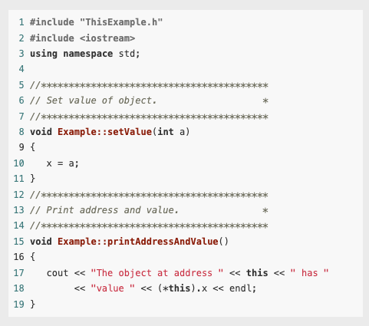
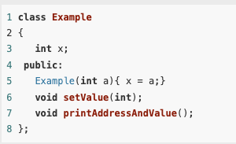
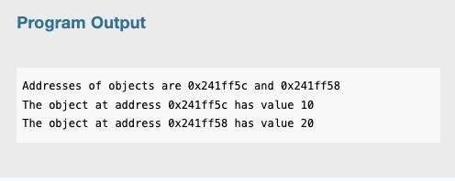
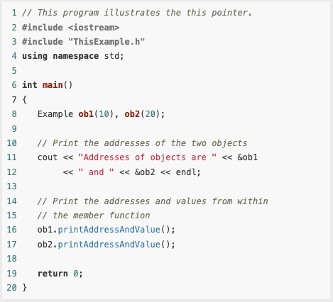
Example

Slide 44
Constant Member Functions
A parameter that is passed to a function by reference or through a pointer may be modified by that function.
The const key word is used with a parameter to prevent the called function from modifying it.
For example, a function declared as void fun(const string &str);
Itakes a reference to a string object as a parameter but will not be able to modify the object.
A similar mechanism can be used to protect the implicit parameter *this from being modified by a member function.

Slide 45
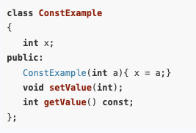
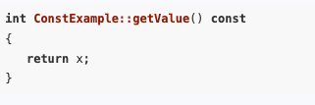
Constant Member Functions
When placed right after the parameter list in the definition of a member function, the const key word serves as an indication to the compiler that the member function should not be allowed to modify its object.
If the member function is defined outside the class, both the in-class declaration and the definition must have the const.

Slide 46
Constant Member Functions
A function with a constant parameter x cannot turn around and pass x as a non-constant parameter to another function.
In other words, a function that promises not to modify x may not pass x to another function unless that second function also promises not to modify x.
This can sometimes occur in ways that are not obvious.
Let’s look at an example:

Slide 47
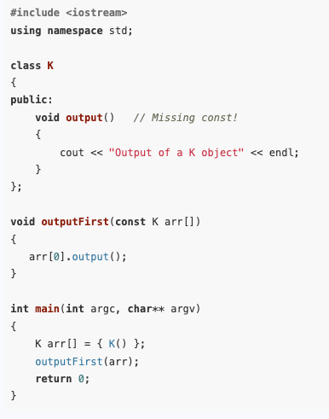
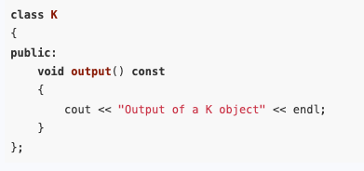
Example
The program uses a function with a constant parameter to print the first element of an array.
It does not compile because it is not consistent in its use of const.
The program does not compile because the compiler cannot guarantee that an element of the const array will not be modified when passed as the implicit this parameter to the output member function: arr[0].output();
You can get the program to compile by making output() a const member function to signify that it has a constant this parameter:
Solution:

